Slide 1

The Business Problem
Given an IT department’s operational data for multiple software machines, is it possible to predict run time anomalies to investigate potential failures and prevent downtimes before they happen.

Slide 2
Context
Software operational data for 100 machines
Anomaly detection in a single machine
Cost reduction
Customer retention

Slide 3
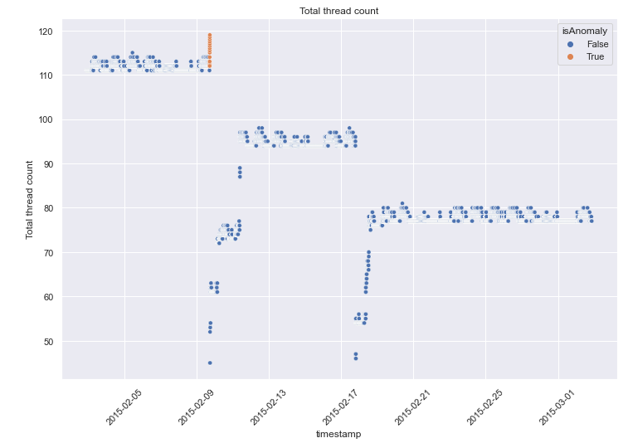
Data Analysis
Anomalies occur when Total thread count reaches ~115
Notes:
Hypothesis: Create a Hypothesis with an emphasis on SMART principles. (S – Specific, M – Measurable, A – Achievable, R – Realistic, T – Timebound). If you cannot do this, you do not have a good grasp on the business problem.
Context: With context, we have clearly identified the problem at hand and have elucidated on how our initiative may solve this problem, alongside the commercial implications this will have on the business.
Criteria for Success: Clearly defining the criteria for success ensures that the scope of your work is clearly defined and understood. Otherwise, if this isn’t defined – your work will never end which will result in mismatched expectations.
Scope of Solution Space: Scoping out the solution space ensures that the business initiative is SPECIFIC for a certain segment or area. This prevents solutions that have been developed being scaled and applied for all other business units that the solution may not be responsible or scalable for.
Constraints within Solution Space: Looking forward, what are the foreseeable problems we are likely to encounter? Could this be stakeholder resistance? Could this be we don’t have access to the right data?
Stakeholders to provide key insight: Who are the people I need to speak to, to get the answers I need for my data analysis?
What key data sources are required?
Based off my discussions with the key stakeholders – can we clearly list out all the data sources we need so we can make a highly targeted request as opposed to a scatter-gun approach where we ask for a bit of everything?

Slide 4
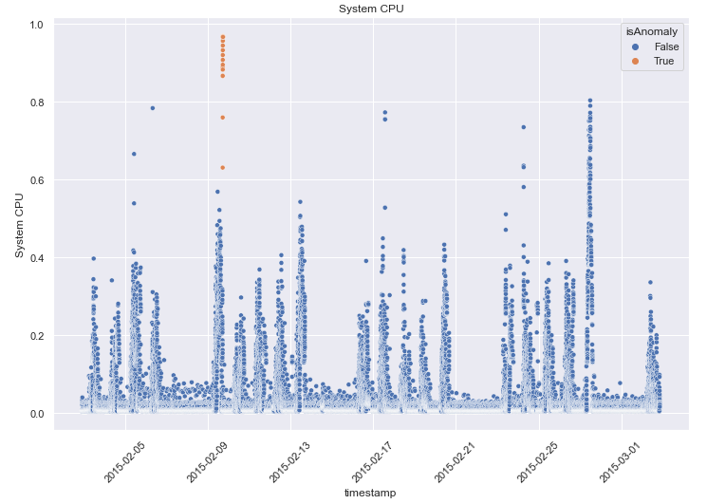
Data Analysis
Anomalies seen when System CPU crosses ~0.85
System recovers after dropping below 0.6

Slide 5
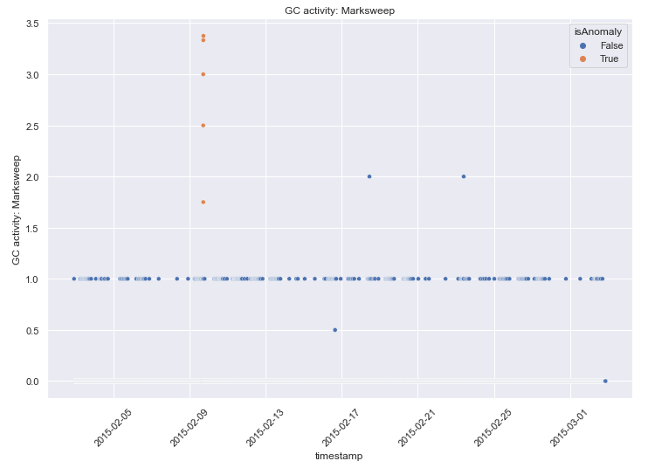
Data Analysis
GC Activity: Marksweep is normally one.
Spikes to 3.5 when anomalies occur.
Notes:
Hypothesis: Create a Hypothesis with an emphasis on SMART principles. (S – Specific, M – Measurable, A – Achievable, R – Realistic, T – Timebound). If you cannot do this, you do not have a good grasp on the business problem.
Context: With context, we have clearly identified the problem at hand and have elucidated on how our initiative may solve this problem, alongside the commercial implications this will have on the business.
Criteria for Success: Clearly defining the criteria for success ensures that the scope of your work is clearly defined and understood. Otherwise, if this isn’t defined – your work will never end which will result in mismatched expectations.
Scope of Solution Space: Scoping out the solution space ensures that the business initiative is SPECIFIC for a certain segment or area. This prevents solutions that have been developed being scaled and applied for all other business units that the solution may not be responsible or scalable for.
Constraints within Solution Space: Looking forward, what are the foreseeable problems we are likely to encounter? Could this be stakeholder resistance? Could this be we don’t have access to the right data?
Stakeholders to provide key insight: Who are the people I need to speak to, to get the answers I need for my data analysis?
What key data sources are required?
Based off my discussions with the key stakeholders – can we clearly list out all the data sources we need so we can make a highly targeted request as opposed to a scatter-gun approach where we ask for a bit of everything?

Slide 6
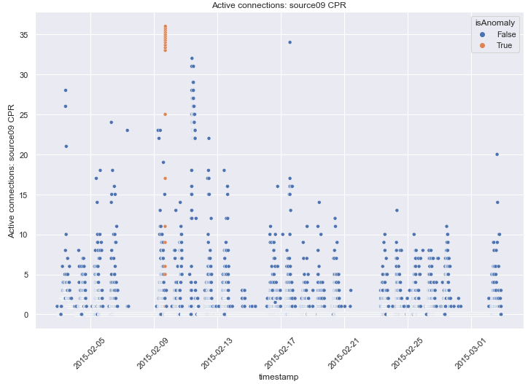
Data Analysis
Failure occurs when Active connections: source09 CPR reach 35 connections.
Notes:
Hypothesis: Create a Hypothesis with an emphasis on SMART principles. (S – Specific, M – Measurable, A – Achievable, R – Realistic, T – Timebound). If you cannot do this, you do not have a good grasp on the business problem.
Context: With context, we have clearly identified the problem at hand and have elucidated on how our initiative may solve this problem, alongside the commercial implications this will have on the business.
Criteria for Success: Clearly defining the criteria for success ensures that the scope of your work is clearly defined and understood. Otherwise, if this isn’t defined – your work will never end which will result in mismatched expectations.
Scope of Solution Space: Scoping out the solution space ensures that the business initiative is SPECIFIC for a certain segment or area. This prevents solutions that have been developed being scaled and applied for all other business units that the solution may not be responsible or scalable for.
Constraints within Solution Space: Looking forward, what are the foreseeable problems we are likely to encounter? Could this be stakeholder resistance? Could this be we don’t have access to the right data?
Stakeholders to provide key insight: Who are the people I need to speak to, to get the answers I need for my data analysis?
What key data sources are required?
Based off my discussions with the key stakeholders – can we clearly list out all the data sources we need so we can make a highly targeted request as opposed to a scatter-gun approach where we ask for a bit of everything?

Slide 7
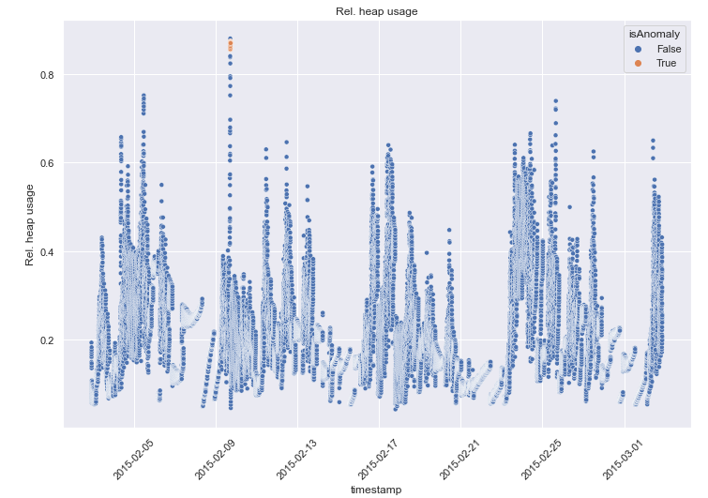
Data Analysis
Anomalies seen after multiple consecutive spikes over 0.8 in Rel. heap usage
Notes:
Hypothesis: Create a Hypothesis with an emphasis on SMART principles. (S – Specific, M – Measurable, A – Achievable, R – Realistic, T – Timebound). If you cannot do this, you do not have a good grasp on the business problem.
Context: With context, we have clearly identified the problem at hand and have elucidated on how our initiative may solve this problem, alongside the commercial implications this will have on the business.
Criteria for Success: Clearly defining the criteria for success ensures that the scope of your work is clearly defined and understood. Otherwise, if this isn’t defined – your work will never end which will result in mismatched expectations.
Scope of Solution Space: Scoping out the solution space ensures that the business initiative is SPECIFIC for a certain segment or area. This prevents solutions that have been developed being scaled and applied for all other business units that the solution may not be responsible or scalable for.
Constraints within Solution Space: Looking forward, what are the foreseeable problems we are likely to encounter? Could this be stakeholder resistance? Could this be we don’t have access to the right data?
Stakeholders to provide key insight: Who are the people I need to speak to, to get the answers I need for my data analysis?
What key data sources are required?
Based off my discussions with the key stakeholders – can we clearly list out all the data sources we need so we can make a highly targeted request as opposed to a scatter-gun approach where we ask for a bit of everything?

Slide 8
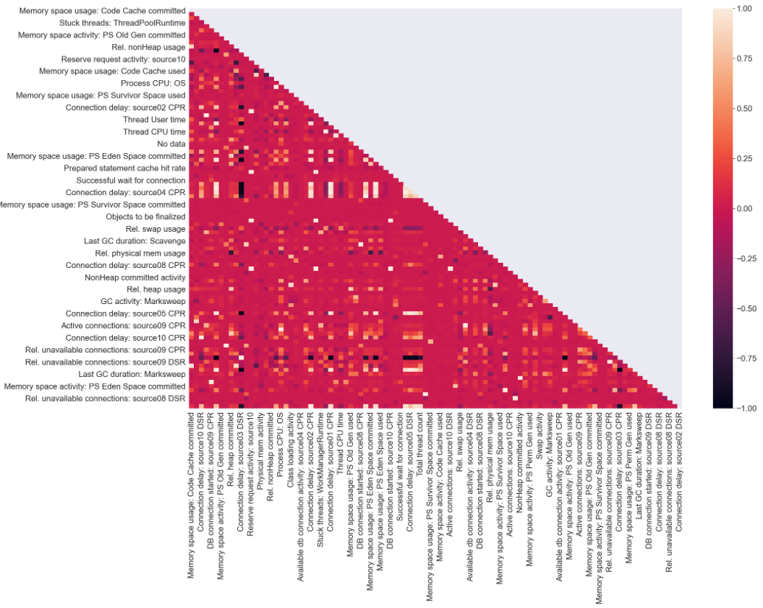
Data Analysis
Multiple features with a moderate to very high degree of correlation
Notes:
Hypothesis: Create a Hypothesis with an emphasis on SMART principles. (S – Specific, M – Measurable, A – Achievable, R – Realistic, T – Timebound). If you cannot do this, you do not have a good grasp on the business problem.
Context: With context, we have clearly identified the problem at hand and have elucidated on how our initiative may solve this problem, alongside the commercial implications this will have on the business.
Criteria for Success: Clearly defining the criteria for success ensures that the scope of your work is clearly defined and understood. Otherwise, if this isn’t defined – your work will never end which will result in mismatched expectations.
Scope of Solution Space: Scoping out the solution space ensures that the business initiative is SPECIFIC for a certain segment or area. This prevents solutions that have been developed being scaled and applied for all other business units that the solution may not be responsible or scalable for.
Constraints within Solution Space: Looking forward, what are the foreseeable problems we are likely to encounter? Could this be stakeholder resistance? Could this be we don’t have access to the right data?
Stakeholders to provide key insight: Who are the people I need to speak to, to get the answers I need for my data analysis?
What key data sources are required?
Based off my discussions with the key stakeholders – can we clearly list out all the data sources we need so we can make a highly targeted request as opposed to a scatter-gun approach where we ask for a bit of everything?

Slide 9
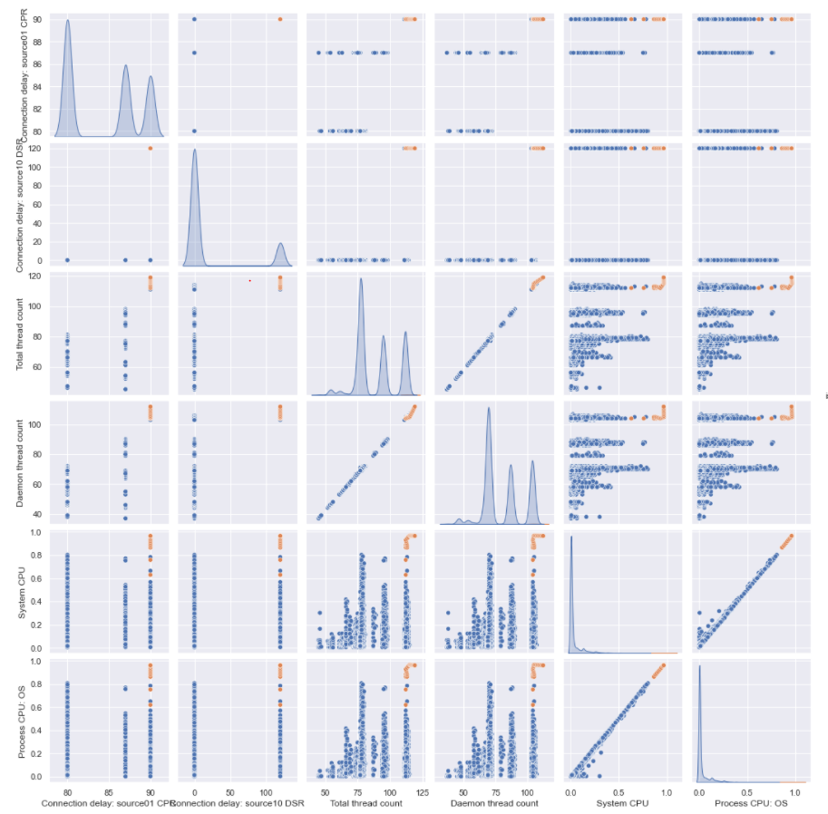
Highly correlated features:
Connection delay: source01 CPR <> Connection delay: source10 DSR
Total thread count <> Daemon thread count
System CPU <> Process CPU: OS
Thread counts spike > system and process CPU spike
System and process CPU spike > delays spike

Slide 10
Modelling
Algorithms compared – Random Forest, Logistic Regression, XG Boost
Metric for scoring – Area under ROC curve
Algorithm chosen – XG Boost Classifier
Notes:
Hypothesis: Create a Hypothesis with an emphasis on SMART principles. (S – Specific, M – Measurable, A – Achievable, R – Realistic, T – Timebound). If you cannot do this, you do not have a good grasp on the business problem.
Context: With context, we have clearly identified the problem at hand and have elucidated on how our initiative may solve this problem, alongside the commercial implications this will have on the business.
Criteria for Success: Clearly defining the criteria for success ensures that the scope of your work is clearly defined and understood. Otherwise, if this isn’t defined – your work will never end which will result in mismatched expectations.
Scope of Solution Space: Scoping out the solution space ensures that the business initiative is SPECIFIC for a certain segment or area. This prevents solutions that have been developed being scaled and applied for all other business units that the solution may not be responsible or scalable for.
Constraints within Solution Space: Looking forward, what are the foreseeable problems we are likely to encounter? Could this be stakeholder resistance? Could this be we don’t have access to the right data?
Stakeholders to provide key insight: Who are the people I need to speak to, to get the answers I need for my data analysis?
What key data sources are required?
Based off my discussions with the key stakeholders – can we clearly list out all the data sources we need so we can make a highly targeted request as opposed to a scatter-gun approach where we ask for a bit of everything?

Slide 11
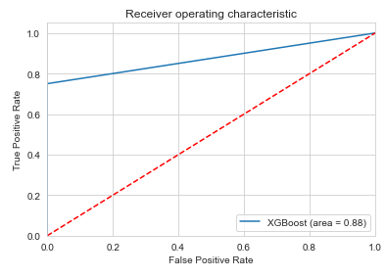

Modelling
Final score (area under roc curve): 0.88
F1 score: 0.86
Confusion Matrix
Notes:
Hypothesis: Create a Hypothesis with an emphasis on SMART principles. (S – Specific, M – Measurable, A – Achievable, R – Realistic, T – Timebound). If you cannot do this, you do not have a good grasp on the business problem.
Context: With context, we have clearly identified the problem at hand and have elucidated on how our initiative may solve this problem, alongside the commercial implications this will have on the business.
Criteria for Success: Clearly defining the criteria for success ensures that the scope of your work is clearly defined and understood. Otherwise, if this isn’t defined – your work will never end which will result in mismatched expectations.
Scope of Solution Space: Scoping out the solution space ensures that the business initiative is SPECIFIC for a certain segment or area. This prevents solutions that have been developed being scaled and applied for all other business units that the solution may not be responsible or scalable for.
Constraints within Solution Space: Looking forward, what are the foreseeable problems we are likely to encounter? Could this be stakeholder resistance? Could this be we don’t have access to the right data?
Stakeholders to provide key insight: Who are the people I need to speak to, to get the answers I need for my data analysis?
What key data sources are required?
Based off my discussions with the key stakeholders – can we clearly list out all the data sources we need so we can make a highly targeted request as opposed to a scatter-gun approach where we ask for a bit of everything?

Slide 12
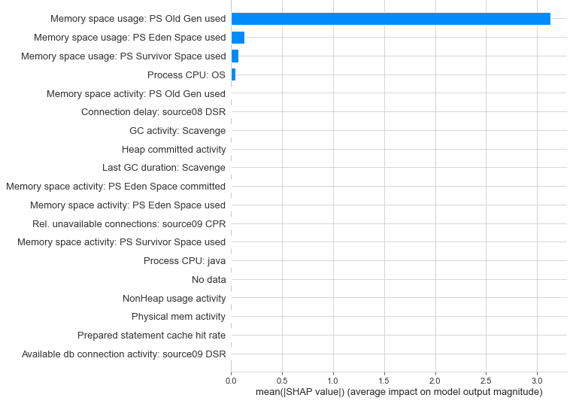
Most Important Features for Anomaly Detection
Notes:
Hypothesis: Create a Hypothesis with an emphasis on SMART principles. (S – Specific, M – Measurable, A – Achievable, R – Realistic, T – Timebound). If you cannot do this, you do not have a good grasp on the business problem.
Context: With context, we have clearly identified the problem at hand and have elucidated on how our initiative may solve this problem, alongside the commercial implications this will have on the business.
Criteria for Success: Clearly defining the criteria for success ensures that the scope of your work is clearly defined and understood. Otherwise, if this isn’t defined – your work will never end which will result in mismatched expectations.
Scope of Solution Space: Scoping out the solution space ensures that the business initiative is SPECIFIC for a certain segment or area. This prevents solutions that have been developed being scaled and applied for all other business units that the solution may not be responsible or scalable for.
Constraints within Solution Space: Looking forward, what are the foreseeable problems we are likely to encounter? Could this be stakeholder resistance? Could this be we don’t have access to the right data?
Stakeholders to provide key insight: Who are the people I need to speak to, to get the answers I need for my data analysis?
What key data sources are required?
Based off my discussions with the key stakeholders – can we clearly list out all the data sources we need so we can make a highly targeted request as opposed to a scatter-gun approach where we ask for a bit of everything?

Slide 13
Recommendation
Implement thresholds to alert stakeholders:
System CPU – 0.91
Last GC duration: Marksweep – 1897
Memory space usage: PS Eden Space used – 0.56
Connection delay: source08 CPR – 61

Slide 14
Future scope
Record more data for better cutoff limits
Analyze all software machines for additional cost savings
Time series analysis after enough data has been collected
Notes:
Hypothesis: Create a Hypothesis with an emphasis on SMART principles. (S – Specific, M – Measurable, A – Achievable, R – Realistic, T – Timebound). If you cannot do this, you do not have a good grasp on the business problem.
Context: With context, we have clearly identified the problem at hand and have elucidated on how our initiative may solve this problem, alongside the commercial implications this will have on the business.
Criteria for Success: Clearly defining the criteria for success ensures that the scope of your work is clearly defined and understood. Otherwise, if this isn’t defined – your work will never end which will result in mismatched expectations.
Scope of Solution Space: Scoping out the solution space ensures that the business initiative is SPECIFIC for a certain segment or area. This prevents solutions that have been developed being scaled and applied for all other business units that the solution may not be responsible or scalable for.
Constraints within Solution Space: Looking forward, what are the foreseeable problems we are likely to encounter? Could this be stakeholder resistance? Could this be we don’t have access to the right data?
Stakeholders to provide key insight: Who are the people I need to speak to, to get the answers I need for my data analysis?
What key data sources are required?
Based off my discussions with the key stakeholders – can we clearly list out all the data sources we need so we can make a highly targeted request as opposed to a scatter-gun approach where we ask for a bit of everything?

